Slide 1
A Programmer: hates spagetti
Python Programming

Slide 2
Independent components
Only coffee_machine imports other component files (i.e. from other folders)
Components don't talk to each other

Slide 3
Trivial Programs
A predictable sequence of function calls
Simple logical structure
No error states
Write it and go home...

Slide 4
Interesting Programs
Execution-path depends on:
run-time data
error states
The program has multiple states

Slide 5
Horrible Programs
Program state is not explicit
complex tests calculate current state
state changes are hidden
very difficult to ensure correctness
very difficult to modify

Slide 6
Encapsulate State Changes
State_machine
Define names for possible states
Maintain a value representing the current state
Selects functions for that state
Receives values from function-calls
Changes state when necessary

Slide 7
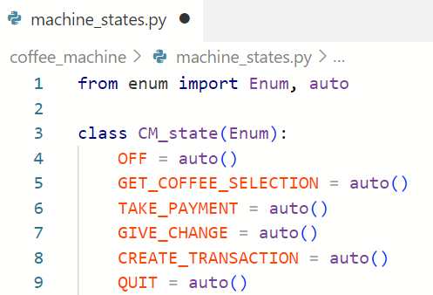
Define States

Slide 8
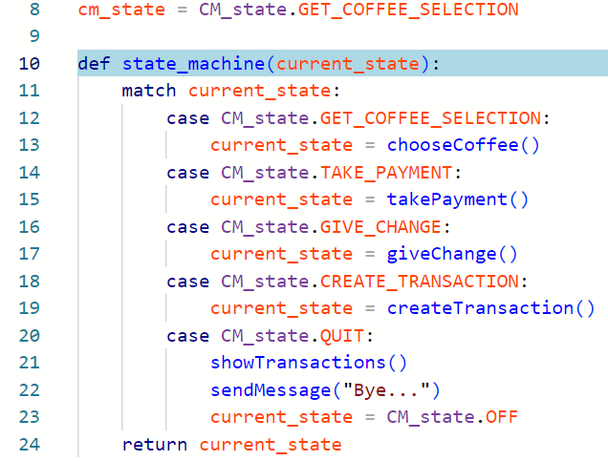
State Machine

Slide 9
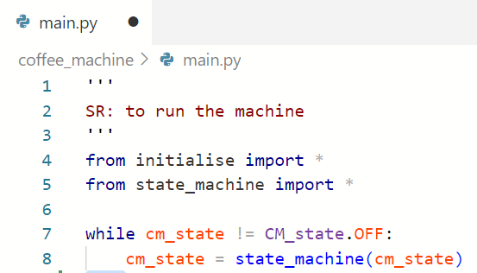
main()

Slide 10
Who Is Responsible?
What responsibilities does each component have?
Who is responsible for
Deciding the recipe for each coffee-type?
Deciding which types the machine can offer?
Processing Payments?
...

Slide 11
What is the UI responsible for?
Asking for input
Giving helpful prompts
Checking for valid input
Checking for in-range input
Returning the answer
Reporting problems
Knowing what coffee-types are called?
Knowing what coffee-types are available?

